Slide 1
Prediction of Recovery Factor using Machine Learning Methods Munish Kumar, Kannappan Swaminathan, Abel Thomas-Hy & Aizat Rusli
July 2022

Slide 2
Disclaimer
ERC Equipoise Ltd (“ERCE”) has made every effort to ensure that the interpretations, conclusions and recommendations set out in this presentation are accurate and reliable in accordance with good industry practice. ERCE does not, however, guarantee the correctness of any such interpretations and shall not be liable or responsible for any loss, costs, damages or expenses incurred or sustained by anyone resulting from any interpretation or recommendation made by any of its officers, agents or employees.
This presentation is produced solely for the benefit of and on the instructions of ERCE’s client to whom it is presented, and not for the benefit of any third party. Any third party to whom the client discloses or makes available this presentation shall not be entitled to rely on it or any part of it.
All estimates of reserves and resources in this presentation are provisional and subject to change. The client agrees to ensure that any publication or use of this presentation which makes reference to ERCE shall be published or quoted in its entirety and the client shall not publish or use extracts of this presentation or any edited or amended version of this presentation, without the prior written consent of ERCE.
In the case that any part of this presentation is delivered in digital format, ERCE does not accept any responsibility for edits carried out by the client or any third party or otherwise after such material has been sent by ERCE to the client.
ERCE has used standard petroleum evaluation techniques in the preparation of this report. These techniques combine geophysical and geological knowledge with assessments of porosity and permeability distributions, fluid characteristics and reservoir pressure. There is uncertainty in the measurement and interpretation of basic data. ERCE has estimated the degree of this uncertainty and determined the range of petroleum initially in place and recoverable hydrocarbons. Our methodology adheres to the guidelines of the SPE PRMS, unless specifically instructed to do otherwise. The accuracy of estimates of volumes of oil and gas and production forecasts is a function of the quality and quantity of available data and of engineering interpretation and judgment. While estimates of Reserves and production forecasts, Contingent Resources and Prospective Resources presented herein are considered reasonable, these estimates should be accepted with the understanding that reservoir performance subsequent to the date of the estimate may justify revision, either upward or downward. In the estimation of future cash flows, ERCE has relied upon oil prices and contract terms assumed and provided by the client, which may not reflect future signed contract values. There is no guarantee that actual economic parameters will match the assumed values. The net present value (NPV) calculations presented in this report simply represent discounted future cash flow values. Though NPVs form an integral part of the fair market value estimations, without consideration for other economic criteria they are not to be construed as ERCE’s opinion of fair market value.

Slide 3
Motivation
Recovery Factor (RF) is one the most critical, and sometimes subjective, inputs towards determine field reserve → no clear approach to calculate or estimate given the variety of factors governing its value
Culmination of technical as well as non-technical aspects (analogs, experience based) and can consider both quantitative and qualitative parameters in its evaluation
Estimating Reserves
Analogs
Early Field Life
Volumetric
Early to Mid Field Life
Material Balance
Decline Curve Analysis
Mid to Late Field Life
Numerical Reservoir Simulation
Mid to Late Field Life
Mid to Late Field Life

Slide 4
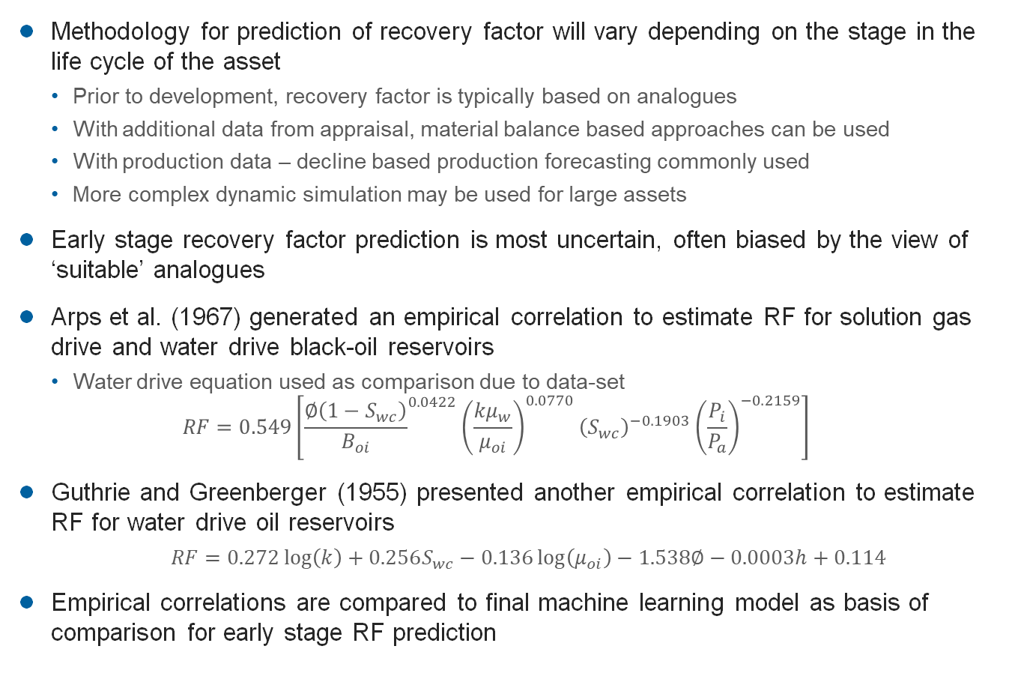
How to Predict Recovery Factor
Methodology for prediction of recovery factor will vary depending on the stage in the life cycle of the asset
Prior to development, recovery factor is typically based on analogues
With additional data from appraisal, material balance based approaches can be used
With production data – decline based production forecasting commonly used
More complex dynamic simulation may be used for large assets
Early stage recovery factor prediction is most uncertain, often biased by the view of ‘suitable’ analogues
Arps et al. (1967) generated an empirical correlation to estimate RF for solution gas drive and water drive black-oil reservoirs
Water drive equation used as comparison due to data-set
$$RF=0.549\left[{\frac{∅\left(1−S_{wc}\right)}{B_{oi}}}^{0.0422}{\left(\frac{kμ_{w}}{μ_{oi}}\right)}^{0.0770}{\left(S_{wc}\right)}^{−0.1903}{\left(\frac{P_{i}}{P_{a}}\right)}^{−0.2159}\right]$$
Guthrie and Greenberger (1955) presented another empirical correlation to estimate RF for water drive oil reservoirs
$RF=0.272\log\left(k\right)+0.256S_{wc}−0.136\log\left(μ_{oi}\right)−1.538∅−0.0003h+0.114$
Empirical correlations are compared to final machine learning model as basis of comparison for early stage RF prediction

Slide 5

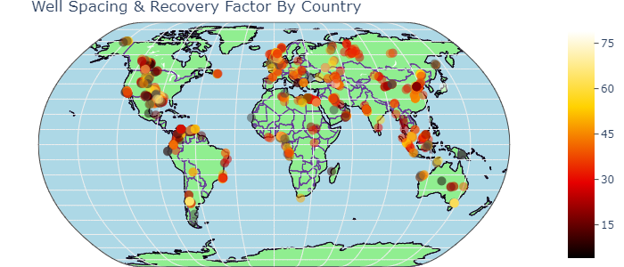


Objectives
Can we predict RF?
Develop a workflow to predict RF by applying machine learning (ML) and artificial intelligence (AI) methods
Use of Geological features
Use of Categorical features
Apply a “low-code” ML approach that simplifies the ML workflow
Investigate and understand variables that can have an impact on Recovery Factor using ML and AI methods
Determine which parameters are of importance “to the machine” in RF prediction
Determine and rank the effectiveness of different algorithms
Understand some of the ML and AI solutions being developed in literature and industry
2 different unstructured Datasets – open-source, fields located in the US, both carbonate and sandstone reservoirs, all fluid types.
Dataset | Categorical columns | Numerical columns | Total Data Set Size | Total Number of Usable Data Points
#1 | 14 | 56 | 96,670 | 9,336
#2 | 17 | 64 | 1,084,914 | 59,175

Slide 6












Machine Learning Approach
Data Collection
Data Preparation
Choose Learning Algorithm
Train the Model
Test the Model
Deployment/ Evaluation on a “Blind” Data Set

Slide 7
Data Sets
Machine learning models developed on two open-source reservoir datasets:
Tertiary Oil Recovery Information System (TORIS) database (1995 Vintage)
Reservoir database including ~2500 crude oil fields, onshore US
Representing ~65% of discovered oil onshore united states
TORIS database focuses primarily on ‘numeric’ inputs, rather than categoric such as geological feature
Inherent bias as many onshore US fields have similar development plans of tight well spacing and water injection
Gulf of Mexico (GOM) database
Collated by Bureau of Ocean Energy Management (US)
860 out of 1319 fields abandoned gives good certainty in recorded recovery factor
RF’s based on volumetric and performance based methods for remaining fields
Dominated by shelf and slope units
Majority of fields developed with water flooding

Slide 8
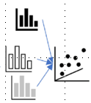

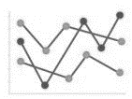
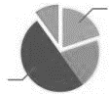

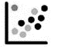

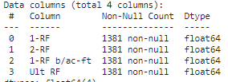
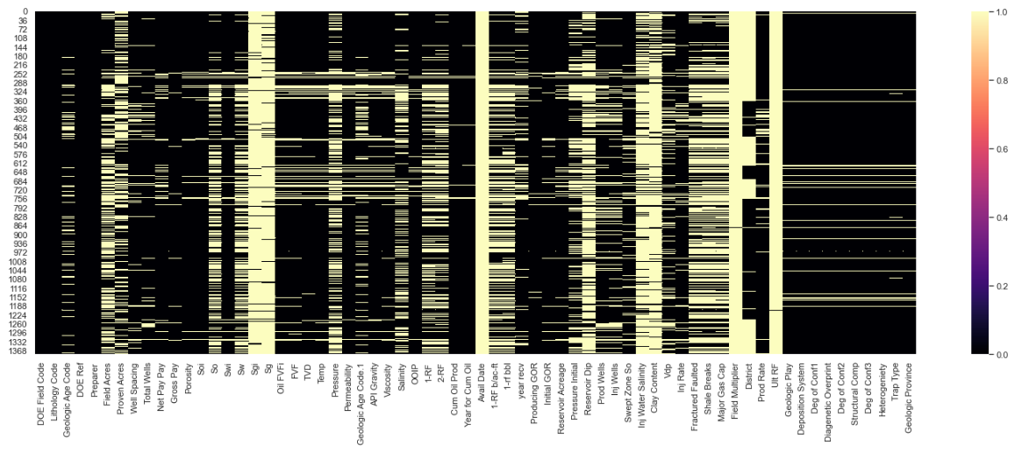
Data Collection & Data Preparation
Exploratory Data Analysis
&
Statistics, grouping of variables, determining nature of variables
Load Data
Attributes?
Uni/ Bi/ Multivariant/ Statistics?
Missing Values, Aberrant, Outliers
Engineer the features
Drop Data based on criteria
Relabel/Combine
Data Cleaning
X | Y
a | b |  | Z
a | b |  | c
a | b |  | NAN
a | b |  | NAN
a | b |  | NAN
 |  |  | NAN
Ultimate Recovery
Factor (URF)
Most time-consuming process; involved removing duplicates, fixing indexes, replacing incorrect characters, normalization of names etc
How to handle Missing Data
Drop the missing variables.
Statistics – look for patterns and fill values based on these
DOMAIN KNOWLEDGE - apply industry learnt relationships to create pseudo-data

Slide 9
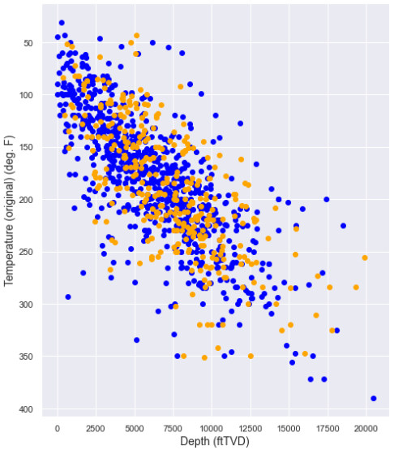
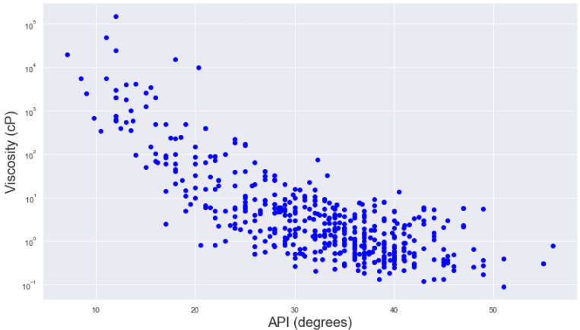

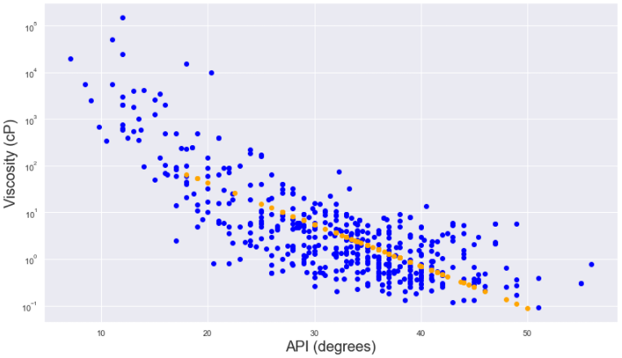
Domain Knowledge to fill Missing Values
Temperature-Depth Correlation
API-Viscosity Correlation
Carbonate
Pre-fit
Sandstone
Post fit
Missing temperature values can be corrected using a “generalised” regression trend.
~Missing viscosity values can be corrected for with a correlation trend line between viscosity and API

Slide 10
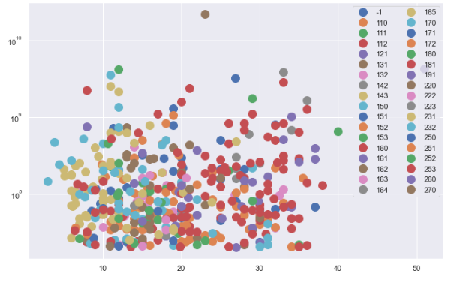
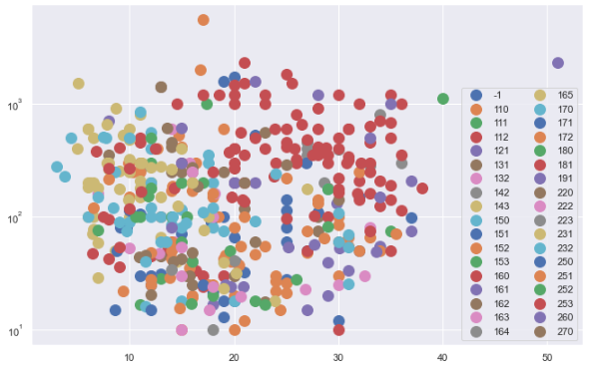
Domain Knowledge (Con’t)
Examples of utilization of Regressions and relationships to fill Missing values are:
Temperature-Depth (Linear - Linear)
Pressure-Depth (Linear - Linear)
Porosity-Permeability (Linear - Log)
API-Viscosity (Linear-Log)
STOIIP-Porosity (Log-Linear)
Dummy Variables – Point Creation & Cumulative Scoring
Correlation ≠ Causality
Domain knowledge informs us that Gross Pay & Porosity are independent variables required to evaluate STOIIP. Therefore, while the 2 plots look similar, correlation for one is possible, but makes no sense for the other (geologically).
Missing values in Gross Pay cannot be correlated with porosity
Gross Pay (ft)
STOIIP (MMstb)
Porosity (%)
Porosity (%)

Slide 11
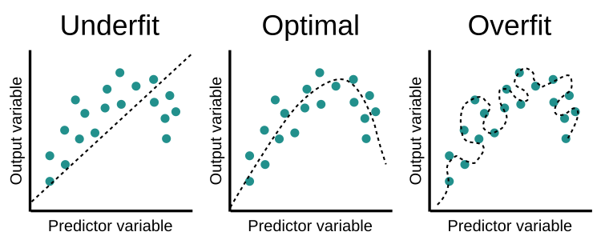
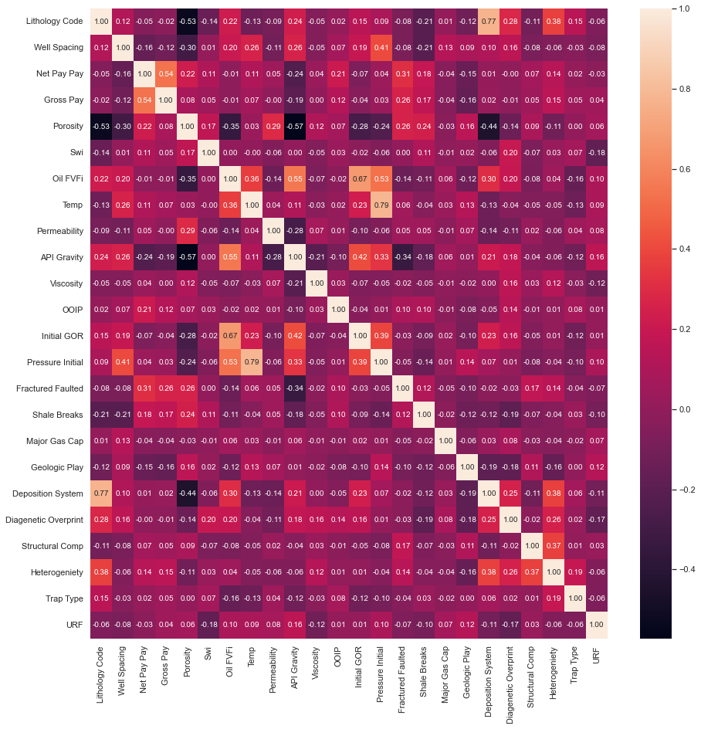
(Multi)collinearity
(Multi)collinearity is a condition where a predictor variable correlates with another predictor variable strongly. Therefore, changes in one of variable would cause changes in the other, giving a highly unstable end model.
Makes it difficult to determine which variables are significant if the model fluctuates greatly
Overfits your model because highly correlatable variables DOMINATE the output
Correlation Matrix – Pairwise Correlation
Highly correlatable values defined as having coefficients > 0.7.
From the plot, the following 3 parameters show collinearity and do not add additional information to the predictive model.
Pressure → Temperature
Depositional System → Lithologic Code
Initial GOR → Oil FVFi
Eliminating one of each pair would allow for a more stable model.

Slide 12
Final Data Inputs For ML Model - TORIS
We applied ML to 2 unique data sets – TORIS and GOM
The following table shows the breakdown of the input variables for the TORIS data set
 | count | - | - | - | - | - | - | -
Lithology Code | 389 | - | - | - | - | - | - | -
Well Spacing | 389 | 36 | 48 | 1 | 10 | 20 | 40 | 640
Net Pay | 389 | 105 | 169 | 5 | 24 | 50 | 122 | 2300
Gross Pay | 389 | 266 | 356 | 10 | 50 | 150 | 300 | 2300
Porosity | 389 | 19 | 8 | 3 | 12 | 17.6 | 25 | 51
Swi | 389 | 31 | 10 | 10 | 25 | 30 | 36 | 68
Oil FVF | 389 | 1 | 0 | 1 | 1.099 | 1.2 | 1.33 | 2.127
Temp | 389 | 138 | 44 | 63 | 105 | 130 | 164 | 266
Permeability | 389 | 401 | 1507 | 0.1 | 10 | 52 | 300 | 26816.5
API Gravity | 389 | 32 | 9 | 6 | 27 | 34 | 38 | 52
Viscosity | 389 | 387 | 10468 | 0.07 | 0.81 | 2 | 7 | 200000
OOIP | 389 | 294 | 1210 | 21 | 48 | 884 | 210 | 22000
Initial GOR | 389 | 516 | 472 | 5 | 200 | 421 | 687 | 4000
Initial Pressure | 389 | 2215 | 1368 | 200 | 1250 | 1850 | 2900 | 9500
Fractured Faulted | 389 | 0 | 0 | 0 | 0 | 0 | 1 | 1
Shale Breaks | 389 | 1 | 0 | 0 | 0 | 1 | 1 | 1
Major Gas Cap | 389 | 3 | 46 | 0 | 0 | 0 | 0 | 680
Geological Play | 389 | 623 | 713 | 6 | 44 | 414 | 830 | 2417
Deposition System | 389 | 184 | 38 | 110 | 152 | 181 | 222 | 270
Diagenetic Overprint | 389 | 2 | 2 | 1 | 1 | 1 | 3 | 9
Structural Complexity | 389 | 14 | 9 | 10 | 10 | 10 | 10 | 50
Heterogeniety | 389 | 1 | 1 | 1 | 1 | 1 | 2 | 3
Trap Type | 389 | 2 | 1 | 1 | 2 | 2 | 3 | 3
URF | 389 | 0 | 0 | 0.024 | 0.25 | 0.311 | 0.4 | 0.5073
Data set comprises of 10 categorical data types, and 14 numerical data types. The total data size is 389 values per column, for a total of 9,336 data points

Slide 13
Final Data Inputs For ML Model
The following table shows the breakdown of the input variables for the GOM data set
GOM
 | count | mean | std | min | 0.25 percentile | 0.5 percentile | 0.75 percentile | max
Chronozone | 3945 | - | - | - | - | - | - | -
Original Oil | 3945 | 4835198 | 1.7E+07 | 24 | 221599 | 888893 | 3274200 | 5.6E+08
Depth Sub Sea | 3945 | 9895.03 | 4166.23 | 1350 | 7017 | 9368 | 11700 | 30800
Pay Thickness | 3945 | 25.2256 | 22.7333 | 1 | 11.97 | 19.09 | 30.36 | 325.19
Area | 3945 | 692.577 | 1215.9 | 1 | 110 | 300 | 765 | 20219
Drive Mechanism | 3945 | - | - | - | - | - | - | -
Porosity | 3945 | 0.2862 | 0.03403 | 0.1 | 0.27 | 0.29 | 0.31 | 0.38
Water Saturation | 3945 | 0.27732 | 0.08635 | 0.1 | 0.22 | 0.27 | 0.33 | 0.68
Permeability | 3945 | 428.313 | 467.874 | 1 | 133 | 267 | 547 | 3898
Initial Pressure | 3945 | 5815.8 | 3319.49 | 643 | 3577 | 4954 | 6986 | 21609
Initial Temperature | 3945 | 182.651 | 37.7006 | 47.33 | 156.33 | 182.33 | 207.33 | 305.33
GOR | 3945 | 1073.08 | 628.669 | 100 | 681 | 921 | 1265 | 5000
API | 3945 | 33.2763 | 4.61062 | 11 | 30 | 34 | 36 | 60
BOI | 3945 | 1.50387 | 0.27635 | 1 | 1.326 | 1.448 | 1.606 | 3.324
ORF | 3945 | 0.27594 | 0.14255 | 0.01 | 0.16 | 0.29 | 0.4 | 0.5
Data set comprises of 2 categorical data types, and 13 numerical data types. The total data size is 3945 values per column, for a total of 59,175 data points (~4% of the original data base)

Slide 14
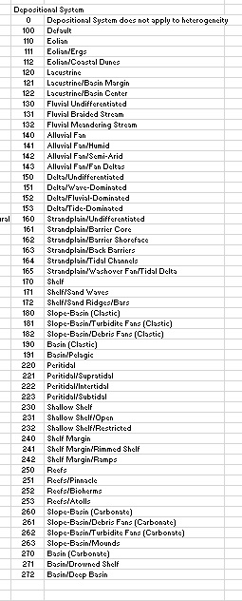
Geological input
An example of a geological input used is the Depositional System in the TORIS model
There were 54 different set of input and was label encoded before being used as a feature for the TORIS model
Other geological features used are
Lithology
Diagenetic Overprint
Fractured / Faulted
Geologic Play
Heterogeneity
Shale Breaks
Structural Compartmentalization
Trap Type
STOIIP (MMstb)
Porosity (%)

Slide 15

Machine Learning Approach
Data Collection
Data Preparation
Choose Learning Algorithm
Train the Model
Test the Model
Deployment/ Evaluation on a “Blind” Data Set

Slide 16

How do you choose the right ML algorithm?
Factors to consider:
Interpretability
The number of data points and features
Data format
Linearity of data
Training time
Prediction time
Memory requirements
→ Not an easy task.
An alternative is to build all and later select the best, but this is time consuming if done “manually”.
→ Low Code Machine Learning Libraries
Image from https://scikit-learn.org/stable/tutorial/machine_learning_map/index.html

Slide 17
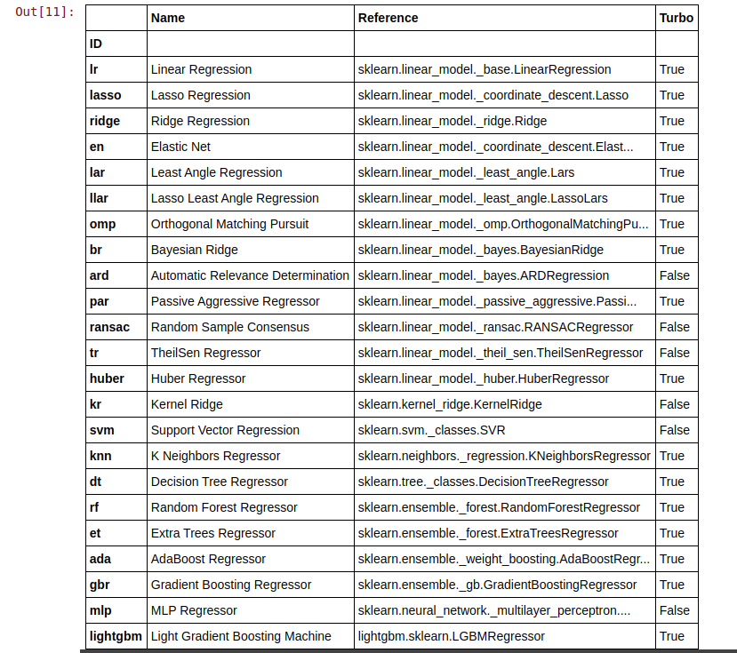
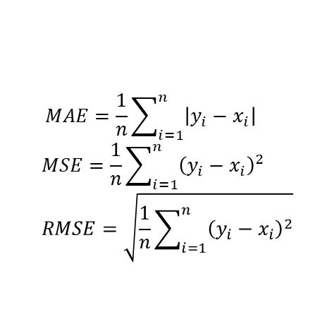
Running the ML algorithms
We apply a supervised learning approach, splitting the raw inputs into a train-validate-test set (70%-20%-10% split). The “train” set is used to build the model, and the “validate” set is used to test that the model works. We “test” the model using a totally new, never-before-seen data set.
A total of 20 models were tested as a first pass* using 10-fold cross validation; these models were ranked using the mean absolute error (MAE), the mean squared error (MSE) and the root mean squared error (RMSE).
Against outliers, the MSE and RMSE perform better
$$MAE=\frac{1}{n}\sum_{i=1}^{n}{\left|y_{i}−x_{i}\right|}$$
$$MSE=\frac{1}{n}\sum_{i=1}^{n}{{\left(y_{i}−x_{i}\right)}^{2}}$$
$$RMSE=\sqrt{\frac{1}{n}\sum_{i=1}^{n}{{\left(y_{i}−x_{i}\right)}^{2}}}$$
Where y_{i} is the prediction, x_{i} is the true value and n is the total number of data points.
We choose 3 unique models based on the Random Forest (RFR), Category Boosting (CatBoost) and the K Neighbour (KNN) Regressors.
Regressor Model (TORIS) | MAE | MSE | RMSE
Random Forest | 0.0791 | 0.0096 | 0.0976
Category Boost | 0.0821 | 0.0104 | 0.1015
K Neighbours | 0.0830 | 0.0109 | 0.1037
Regressor Model (GOM) | MAE | MSE | RMSE
Random Forest | 0.0790 | 0.0096 | 0.0978
Category Boost | 0.0708 | 0.0082 | 0.0906
K Neighbours | 0.1091 | 0.0179 | 0.1339
Notes:
https://dacon.io/codeshare/2430

Slide 18
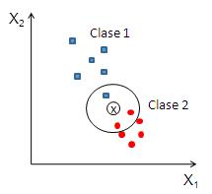
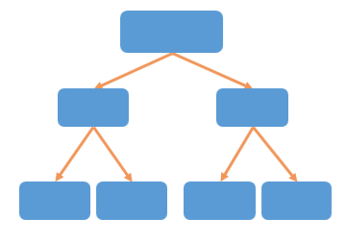
Differences in Algorithms
RFR and CatBoost are linked to decision trees (DT)
DT can overfit; solution is to use an “bootstrapping” and “ensemble average”
CatBoost: Able to handle categorical as well as numeric data. Does this without requiring the conversion of categorical to dummy variables
RFR: Insensitive to outliers, works on large number of variables, hard to overfit, requires a lot of CPU memory.
KNN is a distance-based approach
Predicts based on how closely it matches the points of the training set
Distance methods – Euclidian, Manhattan (for continuous) and Hamming distance (for categorical).
Data Size D
Level = 3
Node = 2
Root
X<x
X>=x
Left Node
Right Node
Y<y
Y>=y
Z<z
Z>=z
Left Node
Right Node
Left Node
Right Node
Y_{hat}
Y_{hat}
Y_{hat}
Y_{hat}
1
2
3
4
X_{L}
3
6
5
4
X_{L}
N
times
2
1
3
6
X_{L}
d< D
X_{L}-Sample generated from bootstrap
Notes:
Decision trees can overfit, which is why it is necessary to either stop at a certain level or stop once the nodes reach a certain size (“Stopping criteria”). Alternatively, one can delete nodes (“Pruning”).
Random Forest:
Instead of examining all features, each tree will only examining a bootstrapped set of samples using only a small but consistent number of unique features. This means that each tree only knows about the data pertaining to a small constant number of features, and a variable number of samples that is less than or equal to that of the original dataset. Consequently, the trees are more likely to return a wider array of answers, derived from more diverse knowledge. This results in a random forest, which possesses numerous benefits over a single decision tree generated without randomness. In a random forest, each tree "votes" on whether or not to classify a sample as positive based on its features. The sample is then classified based on majority vote.
The best method however is known as an “ensemble average” i.e., data set is split into numerous small sets (bootstrapping), a decision tree is created for each, giving N learned models (XL), which can than be combined to give an improved model that is robust to overfitting and outliers.
Ensembling increases the performance of the models (in most cases) we can ensemble our model using bagging, boosting, blending, and stacking in PyCaret

Slide 19
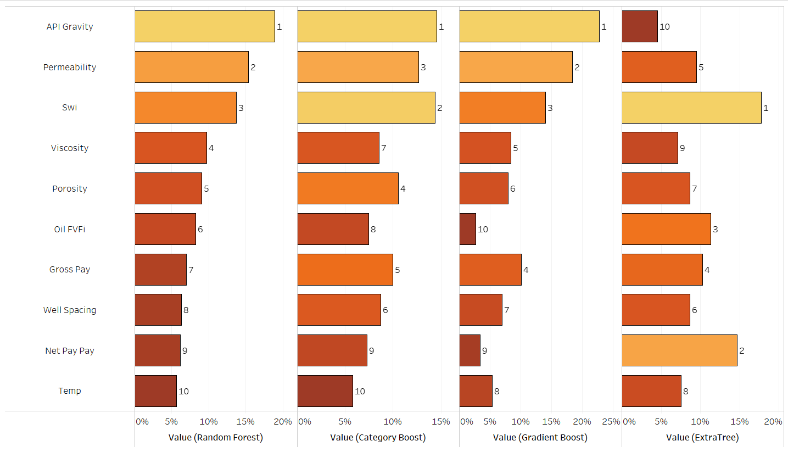

Top 10 Ranked Features for each Model
Some interesting observations for the ranking of the top 10 features:
API, permeability, Swi consistently ranked as among the top 3 important variables
The remaining variables change in importance ranking depending on the algorithm employed
Categorical data has smaller importance, likely due to large degree of categories leading to difficulties in establish trends
Extra tree ranking shows a completely different weighting to all the others
Rank out of sequence

Slide 20
Bias and Variance
As each model considers each feature differently, choosing an optimal model becomes challenging.
However, the end goal is to give an outcome of low bias and variance
Optimal Outcome:
Low Variance
High Variance
Underfitting
High Bias
Truth
Low Bias
Overfitting
Notes:
Bias is the difference between the average prediction of our model and the correct value which we are trying to predict. Model with high bias pays very little attention to the training data and oversimplifies the model. It always leads to high error on training and test data.
Variance is the variability of model prediction for a given data point or a value which tells us spread of our data. Model with high variance pays a lot of attention to training data and does not generalize on the data which it hasn’t seen before. As a result, such models perform very well on training data but has high error rates on test data.

Slide 21
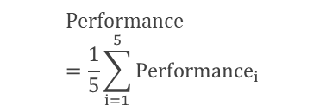
Cross Validation
Since our ML algorithm uses a single input data set, it is difficult to ascertain if it has picked up all the idiosyncrasies in the data – noise, patterns, outliers etc
K-fold Cross-validation allows you to create numerous small data sets by:
Dividing your data set into k subsets
Using (k-1) subsets to train the model, holding one out as a validation set
Validation Fold
Training Fold
1st
Performance₁
2nd
Performance₂
Tested 5, 10 and 15 folds, and found 10 K-folds to be a good compromise in terms of model time
K Iterations (K-Folds)
$$Performance=\frac{1}{5}\sum_{i=1}^{5}{{Performance}_{i}}$$
3rd
Performance₃
4th
Performance₄
5th
Performance₅

Slide 22
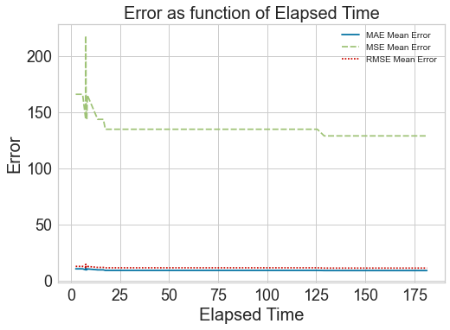
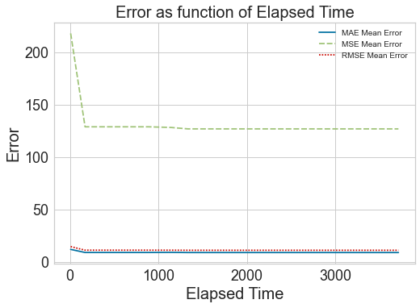
Tuning the Model by varying Hyperparameter
All ML algorithms have parameters that can be modified
These “hyperparameters” can be optimized via a random grid search to regression error (MSE and RMSE) metrics.
Optimization does plateau; more runs or more cross-validation will not reduce the error further.
Experiment 1: K-fold=10 and 50 iterations. Total run time (TRT) ~180s, MAE~9.12
Experiment 2: K-fold=10 and 1000 iterations. Total run time (TRT) ~3600s, MAE~9.07
Local Minimum
Global Minimum
The solution converges rapidly at ~50 iterations in the hyperparameter grid search; adding more iterations to improve model performance is counter-productive since it only increases the computation time
Notes:
For 10-fold cross-validation (i.e. 10 subsets of the full training data), running it 50x means the optimization algorithm tunes the hyperparameters 50 times per model (using gradient descent). The total run time is 180s, and the MAE obtained was 9.12. Repeating this for 1,000 fits results in a run time of >1 hour , but the MAE only reduces to 9.07. Therefore, more iterations does not substantially minimize the error.
hyperparameter is a characteristic of a model that is external to the model and whose value cannot be estimated from data. The value of the hyperparameter has to be set before the learning process begins.
parameter is an internal characteristic of the model and its value can be estimated from data.
Grid search builds a model for every combination of hyperparameters specified and evaluates each model.
In an optimization problem, minimize a function, but we don't know the values of the parameter that minimize that function. Then we use the gradient as information in the direction which to move the parameters, but it doesn't tell us how much to move, so we move a fixed amount (the step size or learning rate). Then considering all of this, if we do one step of moving into the gradient direction, we are closer to the solution (the minimum), but we just moved a little, then we move a little more, and so on. These are iterations. When you increase the number of iterations, you get closer to the minima and the set of optimal parameters, and these are what improve performance.
At each stage same algorithm is being run, but not with the same inputs. The inputs keep changing, as the current value of the parameters changes after one iterations

Slide 23

Combining various ML techniques
Improving the predictive capability of ML an be done by “averaging” different interpreted models (Ensemble Modelling).
Bootstrap Aggregating (Bagging) – take (homogeneous) “weak learners” of the same type (same variables each time, but random subset), pass a prediction through each of them and average the result. Each “weak learner” is independent
Boosting – “Strong learner” = Weighted sum of (homogeneous) “weak learners” with higher importance given to models that were difficult to predict in the previous step.
Blending/ Stacking – combining different “weak learners” – i.e. multiple models are trained to predict the outcome and a meta-model is created that uses the predictions from those models as an input along with the original features.
Single
Bagging
Boosting
Stacking
X
Classifier DT
X: Training Data
Y: Output Data
Y
1 Iteration
X
Classifier SVM
Y
Classifier
Y
…
…
X
Classifier KNN
Y
Parallel
Sequential
Level 0
Level 1
Notes:
https://www.mygreatlearning.com/blog/ensemble-learning/
Weak Learner:
A weak learner is defined to be a classifier that is only slightly correlated with the true classification (it can label examples better than random guessing).
In contrast, a strong learner is a classifier that is arbitrarily well-correlated with the true classification.
Bagging (https://en.wikipedia.org/wiki/Bootstrap_aggregating):
Given a standard training set D of size n, bagging generates m new training sets D_i, each of size n′, by sampling from D uniformly and with replacement. By sampling with replacement, some observations may be repeated in each D_{i}. If n′=n, then for large n the set D_{i} is expected to have the fraction (1 - 1/e) (≈63.2%) of the unique examples of D, the rest being duplicates. This kind of sample is known as a bootstrap sample. Sampling with replacement ensures each bootstrap is independent from its peers, as it does not depend on previous chosen samples when sampling. Then, m models are fitted using the above m bootstrap samples and combined by averaging the output (for regression)
Boosting (https://en.wikipedia.org/wiki/Boosting_(machine_learning)):
While boosting is not algorithmically constrained, most boosting algorithms consist of iteratively learning weak classifiers with respect to a distribution and adding them to a final strong classifier. When they are added, they are weighted in a way that is related to the weak learners' accuracy. After a weak learner is added, the data weights are readjusted, known as "re-weighting". Misclassified input data gain a higher weight and examples that are classified correctly lose weight.[note 1] Thus, future weak learners focus more on the examples that previous weak learners misclassified.
Stacking:
Kfold → create a DT → ML model is used to predict on the entire data set. Results in Pred_M1_DT. Repeat for SVM (Pred_M2_SVM) and KNN (Pred_M3_KNN). We now take Pred_M1_DT, Pred_M2_SVM and Pred_M3_KNN as inputs to a new machine learning model (could be logistic regression, could be anything) and output a trained metal model (M4_META). M4_META is than applied to the test set to get Pred_M4_META. which is the final result.
Blending:
Similar to stacking but training is done on holdout set and test test. New metamodel is fit on holdout set that is made up of original and new data.

Slide 24
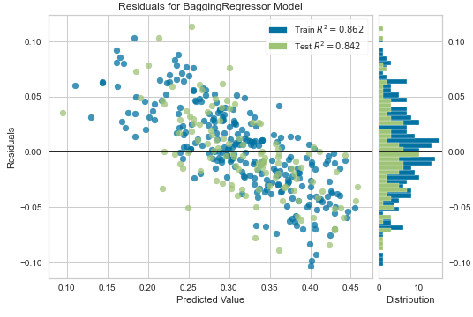
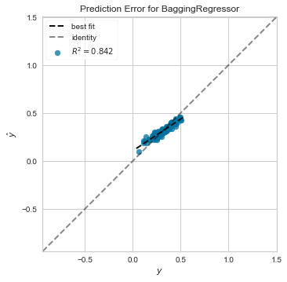
Final Solution (TORIS)
The optimal solution is a blend of all the tuned methods.
Regressor Model | MAE | MSE | RMSE
Pre- Hyper Parameter Tuning
RFR | 0.0791 | 0.0096 | 0.0976
CatBoost | 0.0821 | 0.0104 | 0.1015
KNN | 0.0830 | 0.0109 | 0.1037
Post- Hyper Parameter Tuning
Bagged knn | 0.0734 | 0.0082 | 0.0904
Blend 5 Soft | 0.0731 | 0.0084 | 0.0916
RFR | 0.0791 | 0.0096 | 0.0976
Bagged CatBoost | 0.0741 | 0.0087 | 0.0934
Parameters Tuned |  | Optimised Solution
Error Minimization | MAE, MSE, RMSE | RMSE
Iterations | 0-1000 | 50
Averaging | Bagging/ Boosting | Bagging
Search Algorithm | Random Grid Search, Bayesian, Optuna, Hyperopt | Random Grid Search
Blending? | True/ False | False
Stack | True/ False | False
K-folds | 5, 10, 15 | 10

Slide 25
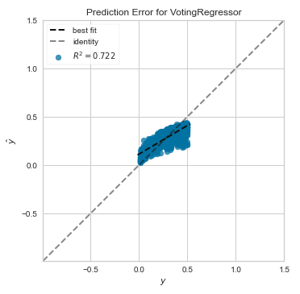
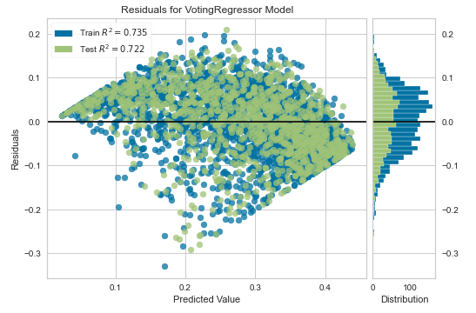
Final Solution (GOM)
The optimal solution is a blend of all the tuned methods.
Regressor Model | MAE | MSE | RMSE
Pre- Hyper Parameter Tuning
RFR | 0.0790 | 0.0096 | 0.0978
CatBoost | 0.0708 | 0.0082 | 0.0906
KNN | 0.1091 | 0.0180 | 0.1339
Post- Hyper Parameter Tuning
CatBoost | 0.0708 | 0.0082 | 0.0906
Bagged CatBoost | 0.0756 | 0.0092 | 0.0958
Stacked | 0.0748 | 0.0094 | 0.0972
RFR | 0.0790 | 0.0096 | 0.0978
Parameters Tuned |  | Optimised Solution
Error Minimization | MAE, MSE, RMSE | RMSE
Iterations | 0-1000 | 50
Averaging | Bagging/ Boosting | None
Search Algorithm | Random Grid Search, Bayesian, Optuna, Hyperopt | Random Grid Search
Blending? | True/ False | False
Stack | True/ False | False
K-folds | 5, 10, 15 | 10

Slide 26
Machine Learning Approach
Data Collection
Data Preparation
Choose Learning Algorithm
Train the Model
Test the Model
Deployment/ Evaluation on a “Blind” Data Set

Slide 27






Deployment – Testing on a Blind Data Set
Machine learning models applied to ‘blind data set’ (hold-out set)
Blind dataset is 10% split of data which had been initially separated from training set
As a double-blind test - ERCE used data from 3 interpreted fields from locations around the world as a test in a ‘real world application’
Former Soviet Union
Onshore
~10-100 mD
~3800 psi
C
Gulf of Mexico
Offshore
<100 mD
~4700 psi
Asia-Pacific
Coastal
100-1000 mD
~2100 psi

Slide 28
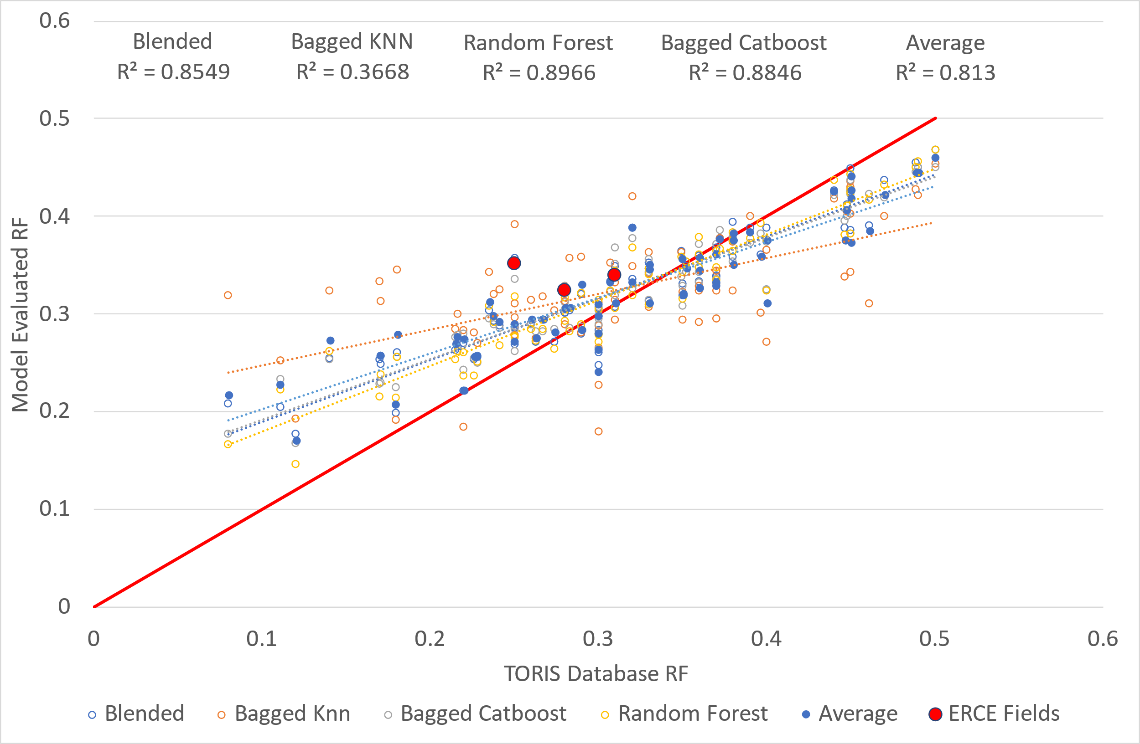
Results on Blind Data set (TORIS)
Results of different models shown in open points – average of all models shown in filled blue points
Difference in ML models show variability in results
All models bar Bagged KNN model show good R² match
General trend of overestimating RF fields with low RF, underestimating RF in fields with high RF
Spread of averaged data points show an error margin of 5-10%

Slide 29
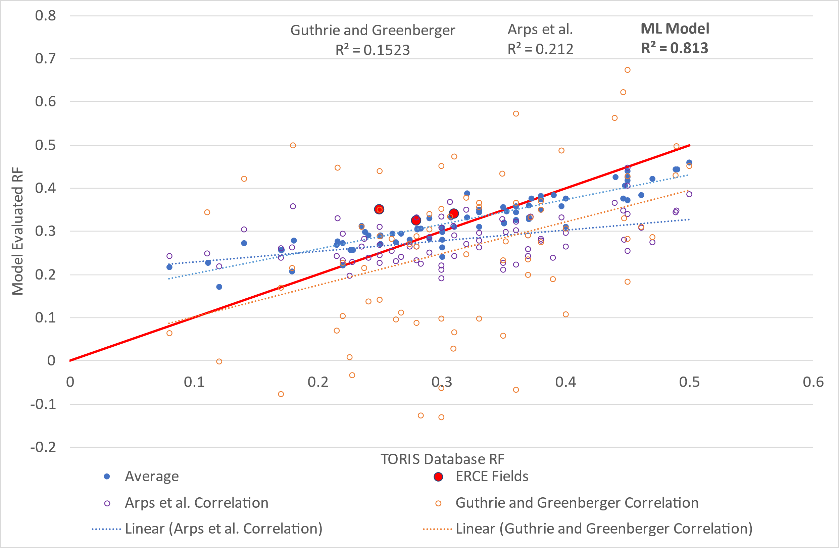
Results on Blind Data set (TORIS)
R² Value
ML Model | Arps et al. | Guthrie and
0.81 | 0.21 | 0.15
ML model shows better R² results than Arps et al. and Guthrie and Greenberger
ML model shows uncertainty of up to 10% when applied to ERCE interpreted fields
Arps et al. show good results for specific field example – however spread of data shows wider uncertainty
Guthrie and Greenberger correlation shows largest spread of data – including some negative recovery factors
Using RF suggested by ML model – User can integrate with domain knowledge to estimate RF
ERCE Interpreted Field Comparsion
Field | TORIS DB | ML Model | Arps et al. | Gurthrie and Greenberger
Former SU | 0.31 | 0.33 | 0.29 | 0.47
GOM | 0.28 | 0.32 | 0.33 | 0.29
Asia Pacific | 0.25 | 0.35 | 0.27 | 0.35

Slide 30
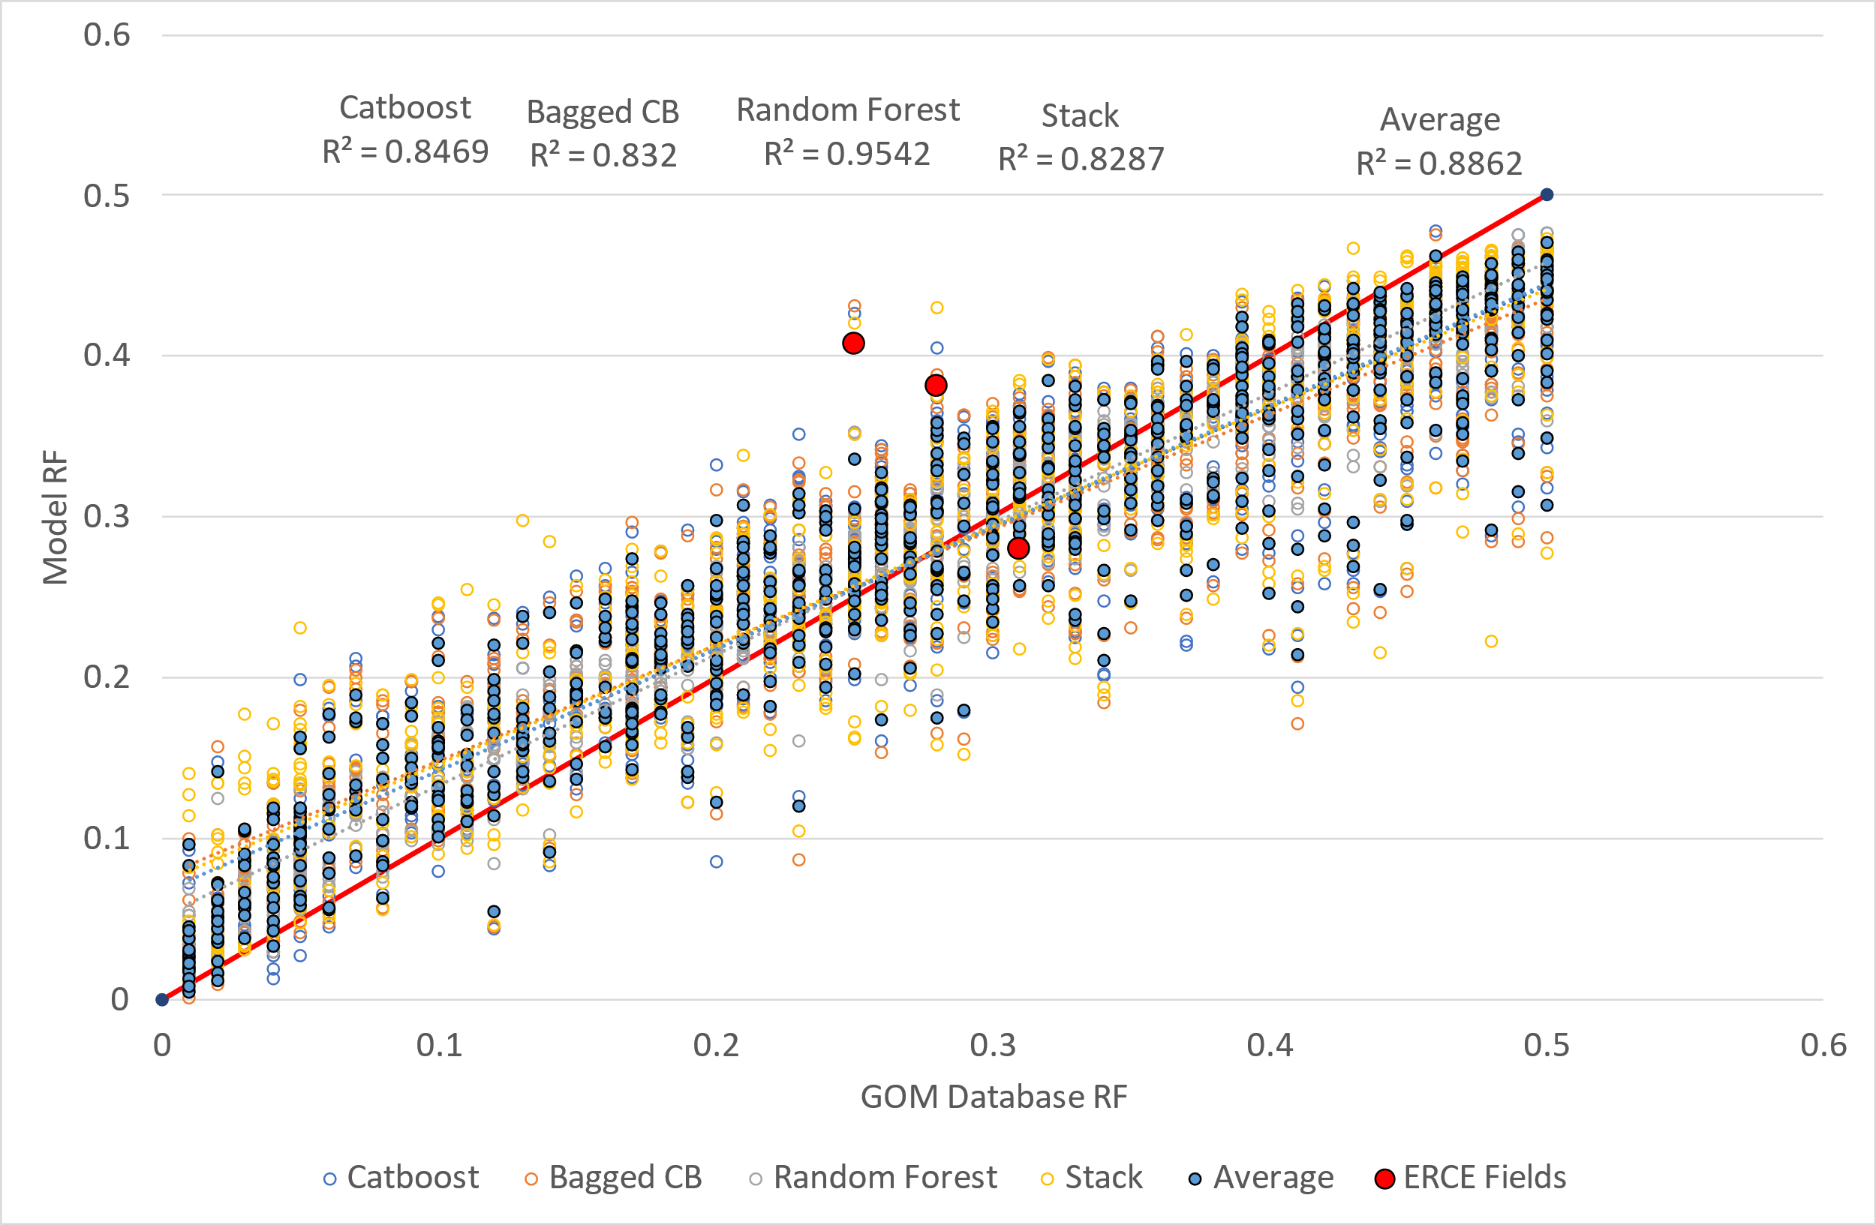
Results on Blind Data set (GOM)
GOM dataset noisier due to reservoir level data compared to field level in TORIS dataset
Higher R² value than TORIS dataset – likely due to more data
General trend of overestimating RF fields with low RF, underestimating RF in fields with high RF still exists
Spread of averaged data points show an error margin of ~10%

Slide 31
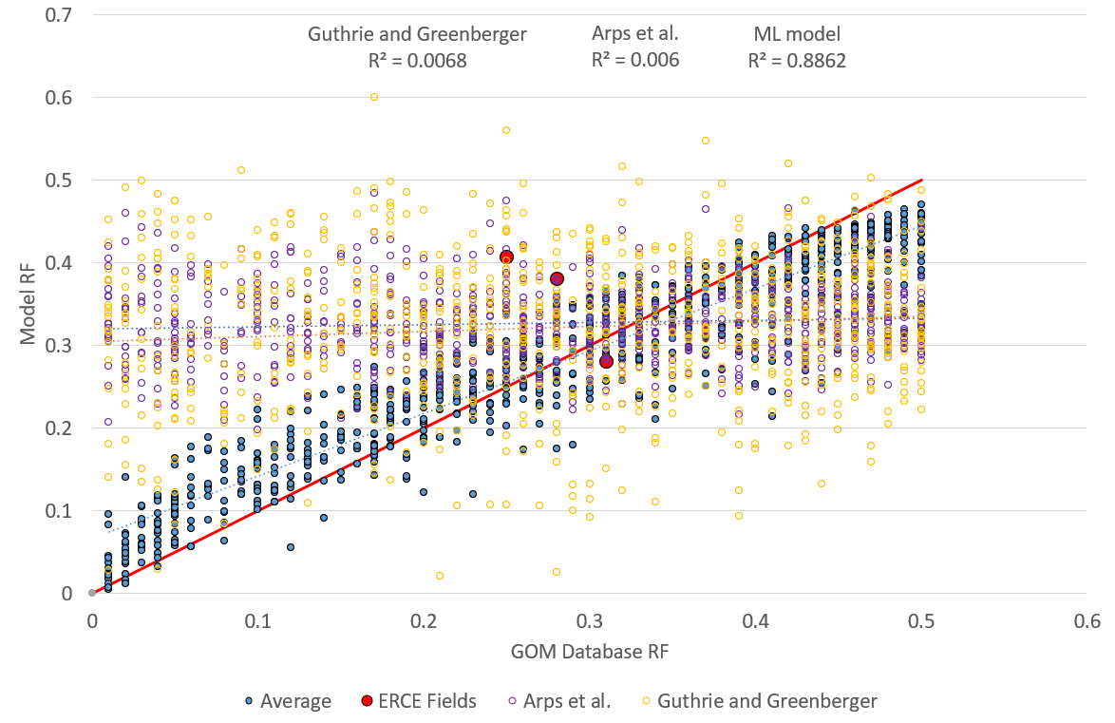
Results on Blind Data set (GOM)
R² Value
ML Model | Arps et al. | Guthrie and
0.88 | 0.006 | 0.007
In GOM dataset – Arps et al. and Guthrie and Greenberger show poor R²
ML Model shows much better results – more datapoints lead to better model
Although ML model shows good R² – field examples show there is still wide range of uncertainty
Using RF suggested by ML model – User can integrate with domain knowledge to estimate RF
ERCE Interpreted Field Comparison
Field | TORIS DB | ML Model | Arps et al. | Gurthrie and Greenberger
Former SU | 0.31 | 0.28 | 0.29 | 0.47
GOM | 0.28 | 0.38 | 0.33 | 0.29
Asia Pacific | 0.25 | 0.40 | 0.27 | 0.35

Slide 32
Discussions/ Learnings/ Conclusions
Models provide basis for recovery factor prediction
Purpose of using the model must be considered
Margin of error (5-10%) shows a model suitable for early life RF estimation – in scenarios where analogues typically used
Must be used with caution in marginal fields where error margin can lead to erroneous decision making
Models are dependent on the quality of the data set
Model biased to the location of data set
Testing GOM model on fields ERCE evaluated in gulf of Mexico shows good results
Testing GOM model on fields in completely different location shows worse results
Model likely underestimates the effects of ‘categoric’ data compared to numerical data
Categoric data separated into too many individual categories – requires mores simplification for trends
Resultant likely underestimation of geological setting
Low code is an effective way to deploy machine learning – but uncertainty in process
Low code allows for rapid testing of multiple learning algorithms
Machine learning model built separately from low code environment shows similar results for one learning algorithm
Models show that machine learning can be effectively implemented to predict recovery given sufficient quality data set as long as domain knowledge respected
Further work in applying to larger – geographically spread data set
Use Neural Networks which are better at non-linearities

